Slide 1
Background Info
How to read these diagrams

Slide 2
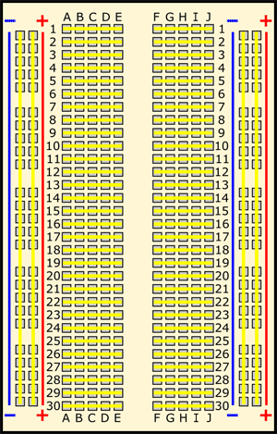
This is called a breadboard
We will connect the second power rail to 5V on the Arduino Nano board
All holes along the red line are called the “power rail” and are connected to each other. We will connect this to red wire of the 9V battery
We will connect the second ground rail to GND on the Arduino Nano board
All holes along the blue line are called the “ground rail” and are connected to each other. We will connect this black wire of the 9V battery
The yellow lines show which holes are connected

Slide 3
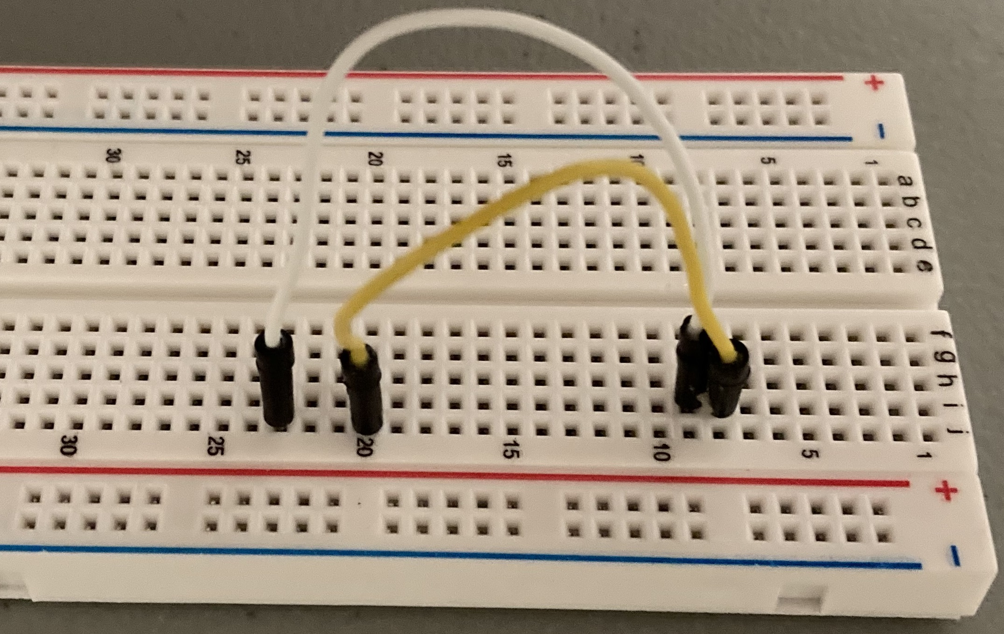
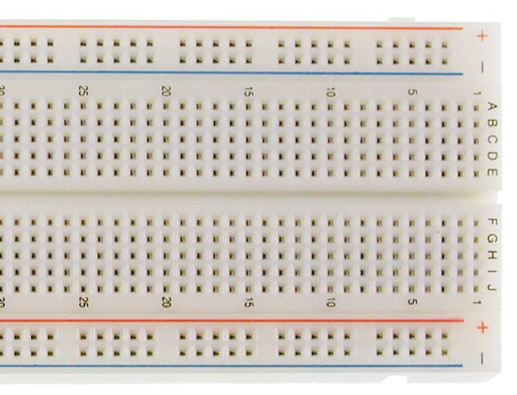
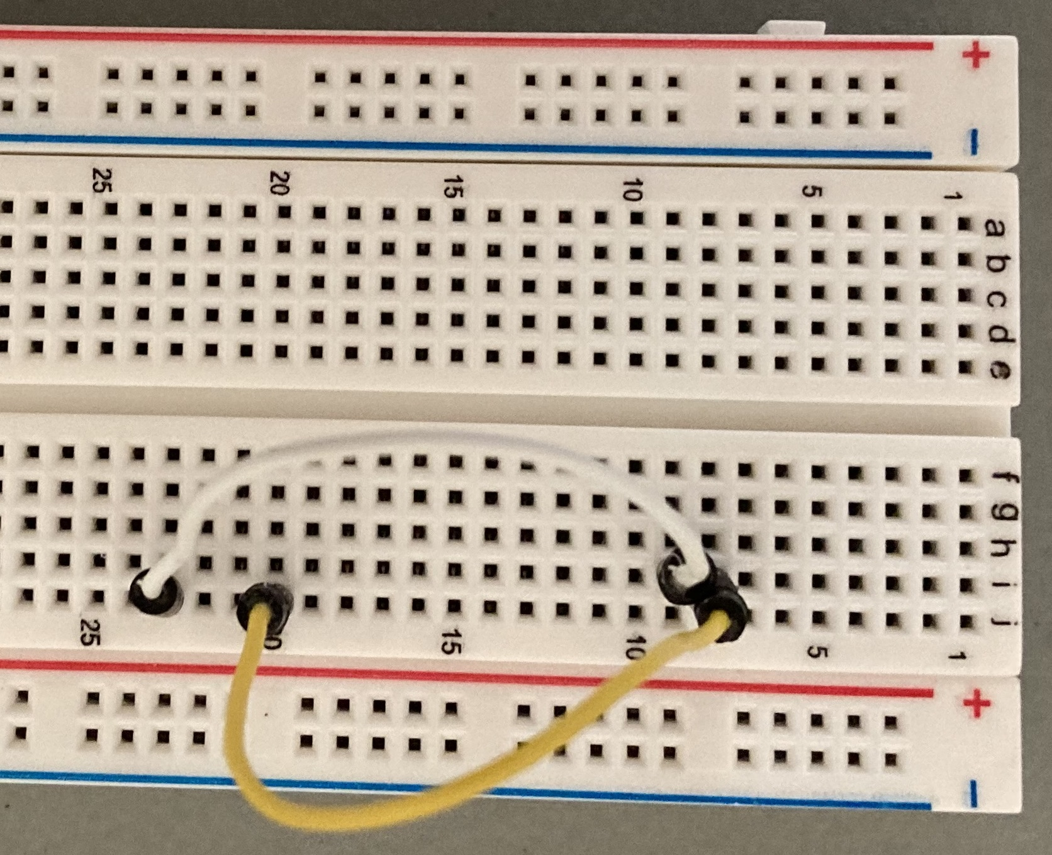
Wire color is not important
In the drawing below, you can see a red line from J23 to I9
The white wire in the picture to the right shows what that actually looks like
You can also see a black line from J20 to I8
The yellow wire in the picture to the tight shows what that actually looks like
Letters identify columns
Numbers identify rows

Slide 4
Assembly
Step by step instructions

Slide 5
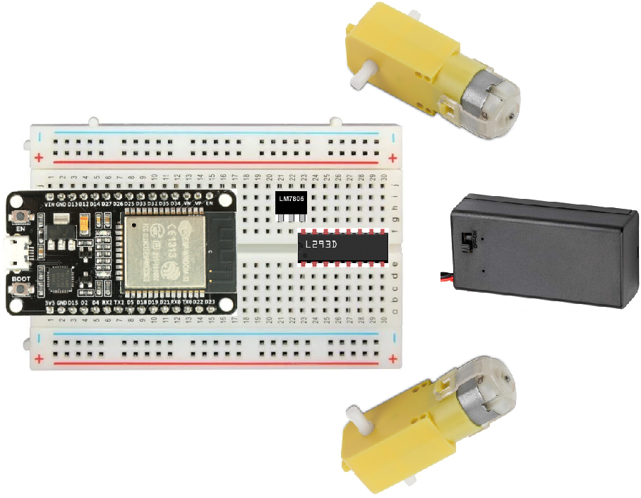
Put 3 chips in locations shown

Slide 6
Add 10 wires to connect power

Slide 7
Add 4 wires (2 per motor)

Slide 8
Add 2 wires for battery

Slide 9
Add 6 wires to connect processor to motors

